Slide 1

Cryptography and Network Security
CS-317
Sir Syed University of Engineering & Technology, Karachi
Department of Computer Science

Slide 2
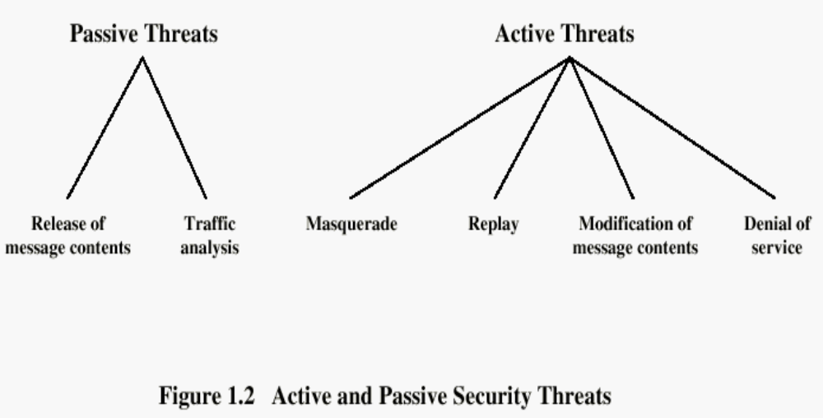
Security Attacks
Learning Assignment: In the notes (below)
Notes:
Learning Assignment: I intentionally included this figure. Attacks have different names. See this topic in the book and Note down the name of these attacks.

Slide 3
Security Attacks
Passive attacks: are in the nature of eavesdropping on, or monitoring of, transmissions
Goal of the opponent is to obtain information that is being transmitted
Active attacks: involve some modification of the data stream or the creation of a false stream

Slide 4

Passive Attack - Interception
This is an attack on confidentiality
Notes:
A useful means of classifying security attacks, used both in X.800 and RFC 2828, is in terms of passive attacks and active attacks. A passive attack attempts to learn or make use of information from the system but does not affect system resources.
Passive attacks are in the nature of eavesdropping on, or monitoring of, transmissions. The goal of the opponent is to obtain information that is being transmitted. Two types of passive attacks are:
+ release of message contents - as shown above in Stallings Figure 1.2a here
+ traffic analysis - monitor traffic flow to determine location and identity of communicating hosts and could observe the frequency and length of messages being exchanged
These attacks are difficult to detect because they do not involve any alteration of the data.

Slide 5
Passive Attack: Traffic Analysis
Observe traffic pattern
Notes:
A useful means of classifying security attacks, used both in X.800 and RFC 2828, is in terms of passive attacks and active attacks. A passive attack attempts to learn or make use of information from the system but does not affect system resources.
Passive attacks are in the nature of eavesdropping on, or monitoring of, transmissions. The goal of the opponent is to obtain information that is being transmitted. Two types of passive attacks are:
+ release of message contents - as shown above in Stallings Figure 1.2a here
+ traffic analysis - monitor traffic flow to determine location and identity of communicating hosts and could observe the frequency and length of messages being exchanged
These attacks are difficult to detect because they do not involve any alteration of the data.

Slide 6
Active Attack: Interruption
Block delivery of message
This is an attack on availability
Notes:
A useful means of classifying security attacks, used both in X.800 and RFC 2828, is in terms of passive attacks and active attacks. A passive attack attempts to learn or make use of information from the system but does not affect system resources.
Passive attacks are in the nature of eavesdropping on, or monitoring of, transmissions. The goal of the opponent is to obtain information that is being transmitted. Two types of passive attacks are:
+ release of message contents - as shown above in Stallings Figure 1.2a here
+ traffic analysis - monitor traffic flow to determine location and identity of communicating hosts and could observe the frequency and length of messages being exchanged
These attacks are difficult to detect because they do not involve any alteration of the data.

Slide 7
Active Attack: Fabrication
Fabricate message
This is an attack on authenticity
Notes:
A useful means of classifying security attacks, used both in X.800 and RFC 2828, is in terms of passive attacks and active attacks. A passive attack attempts to learn or make use of information from the system but does not affect system resources.
Passive attacks are in the nature of eavesdropping on, or monitoring of, transmissions. The goal of the opponent is to obtain information that is being transmitted. Two types of passive attacks are:
+ release of message contents - as shown above in Stallings Figure 1.2a here
+ traffic analysis - monitor traffic flow to determine location and identity of communicating hosts and could observe the frequency and length of messages being exchanged
These attacks are difficult to detect because they do not involve any alteration of the data.

Slide 8

Active Attack: Replay
Notes:
Active attacks involve some modification of the data stream or the creation of a false stream and can be subdivided into four categories: masquerade, replay, modification of messages, and denial of service:
masquerade of one entity as some other
replay previous messages (as shown above in Stallings Figure 1.3b)
modify/alter (part of) messages in transit to produce an unauthorized effect
denial of service - prevents or inhibits the normal use or management of communications facilities
Active attacks present the opposite characteristics of passive attacks. Whereas passive attacks are difficult to detect, measures are available to prevent their success. On the other hand, it is quite difficult to prevent active attacks absolutely, because of the wide variety of potential physical, software, and network vulnerabilities. Instead, the goal is to detect active attacks and to recover from any disruption or delays caused by them.

Slide 9
Active Attack: Modification
Modify message
This is an attack on integrity
Notes:
Active attacks involve some modification of the data stream or the creation of a false stream and can be subdivided into four categories: masquerade, replay, modification of messages, and denial of service:
masquerade of one entity as some other
replay previous messages (as shown above in Stallings Figure 1.3b)
modify/alter (part of) messages in transit to produce an unauthorized effect
denial of service - prevents or inhibits the normal use or management of communications facilities
Active attacks present the opposite characteristics of passive attacks. Whereas passive attacks are difficult to detect, measures are available to prevent their success. On the other hand, it is quite difficult to prevent active attacks absolutely, because of the wide variety of potential physical, software, and network vulnerabilities. Instead, the goal is to detect active attacks and to recover from any disruption or delays caused by them.

Slide 10
Handling Attacks
  Passive attacks – focus on Prevention
    Easy to stop
    Hard to detect
  Active attacks – focus on Detection and Recovery
    Hard to stop
    Easy to detect
Notes:
Consider the role of a security service, and what may be required.
Note both similarities and differences with traditional paper documents, which for example:
have signatures & dates;
need protection from disclosure, tampering, or destruction;
may be notarized or witnessed;
may be recorded or licensed

Slide 11
How to do an Attack
The following describes some of the ways through which any information systems can be attacked.
Social Engineering
Viruses / Trojan Horses / Worms
Denial of Service (DoS)
IP Spoofing
Replay Attack

Slide 12
Social Engineering
Social engineering is a technique used by attackers to gain system access or information by exploiting the basic human instinct to be helpful.
Social engineering exploit are successful because the targeted enterprise lacks an awareness program to educate employees of their security-related duties and responsibilities.
A simple phone call by an intruder to a target posing as a network support guy and asking her username and password to rectify a non existing problem.

Slide 13
Viruses / Trojan Horses / Worms
Virus is malicious code that can plant itself into operating systems and programs and modify them.
Trojan-horse is a virus that is hidden inside a legitimate software. Once the software is installed or downloaded, the malicious code does its thing.
Worm is industry nomenclature for a self-contained program that will replicate itself across a network, infecting each server and workstation it can access.

Slide 14
Denial of Service (DoS)
An attack that targets resources within the network with the intention of reserving resource and keeping legitimate users from gaining access.
During a SYN attack, an enemy workstation will generate a flood of session requests using bogus IP addresses.
The target server begins reserving resources for each request while waiting for the completion of the TCP/IP handshake process.
The expected reply from the enemy workstation never comes but the reserved resources results in the denial of service for the legitimate user.
Notes:
If you add it all together, you can see that the target machine allocates resources for more than 3 minutes to respond to just one SYN attack
This DoS attack essentially involves flooding a server with a barrage of hand-crafted requests for connection

Slide 15
IP Spoofing
IP spoofing is accomplished when an outside hacker uses a discovered IP address to gain access of a trusted environment from outside the network.
A hacker can obtain a valid IP address in a variety of ways such as social engineering.

Slide 16
Replay Attack
A replay attack occurs when a hacker intercepts a communication between two parties and replays the message.
For instance, a hacker might intercept a credit card transaction between a consumer and a Web site. The hacker then replays the transaction multiple times resulting in multiple debits to the consumers credit account.

